Slide 1
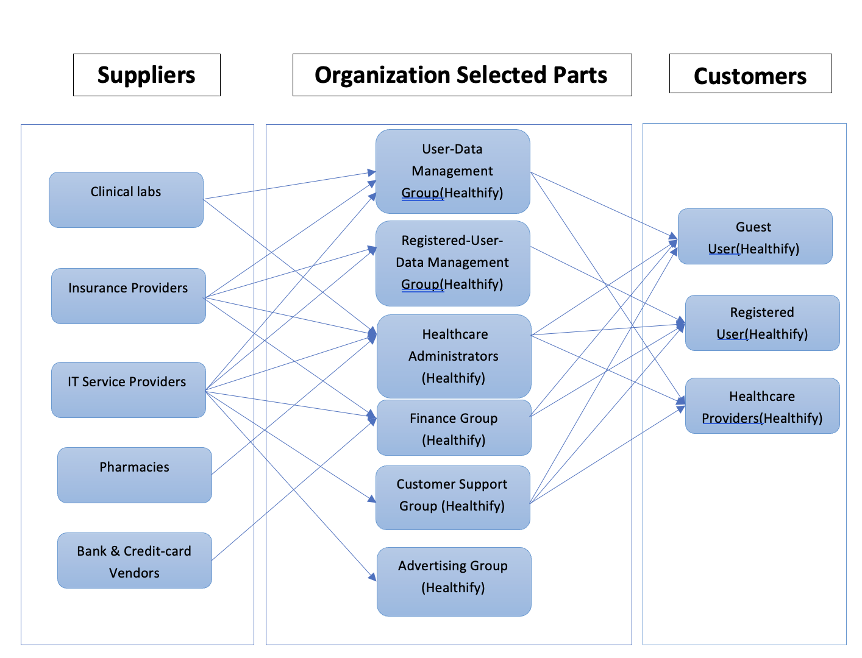
Health-care Management system- BRM Diagram

Slide 2
Health-care Management System: SIPOC Diagram
S
I
P
O
C
Supplier
Inputs
Process
Outputs
Customers
Clinical Labs
Insurance Providers
IT Service Providers
Pharmacies
Bank & Credit card Vendors
Patient information
Appointment requests
Insurance information
Advertisements
Bank Transactions
User-Data Management
Appointment Confirmations
Test Results
Billing Invoices
Prescription processing
Customer Support
Feedback
Registered-Data Management
Guest User
Registered User
Health care Providers
Health care Administrators
Finance Groups
Customer Support Group
Advertising Group

Slide 3
User Roles by Business Group
External Users (Customers)
Guest Users (Arjun Reddy Nareddy)
Registered User (Venkata Reddy Doggala)
Healthcare Providers (Rasheed)
Internal Users
Team Members gather business requirements for their assigned business stakeholders.
Business Group | User Roles | Team Member Name (Bus. Group Proxy)
User-data Management | Database Administrator 1 | Arjun Reddy Nareddy
Registered User-data Management | Database Administrator 2 | Venkata Reddy Doggala
Health care Administrators | Health Information Technologists | Surekha Maruti Salunkhe
Finance Group | Financial Analyst | Dheeraj
Customer Support Group | Customer Success Manager | Nikhil
Advertising Group | Digital Marketing Specialist | Madhvika

